Slide 1

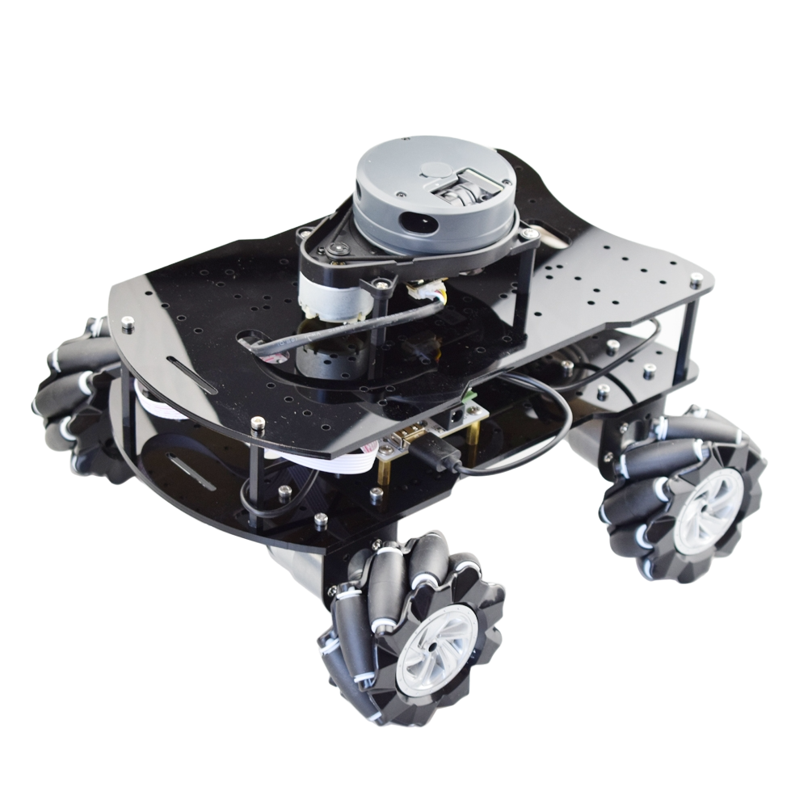
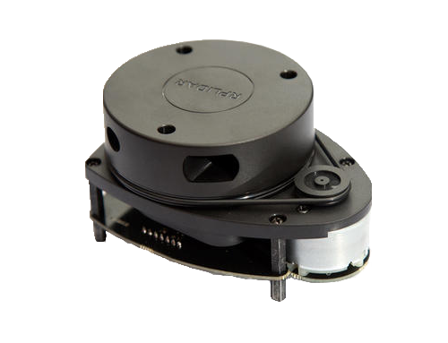
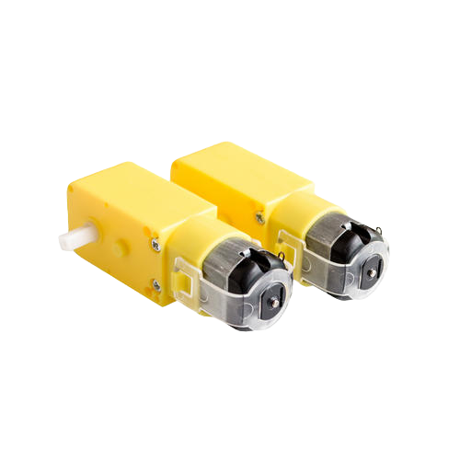
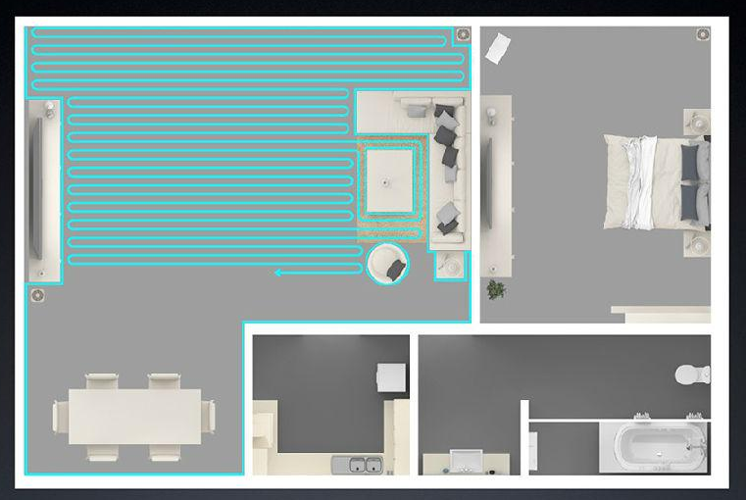
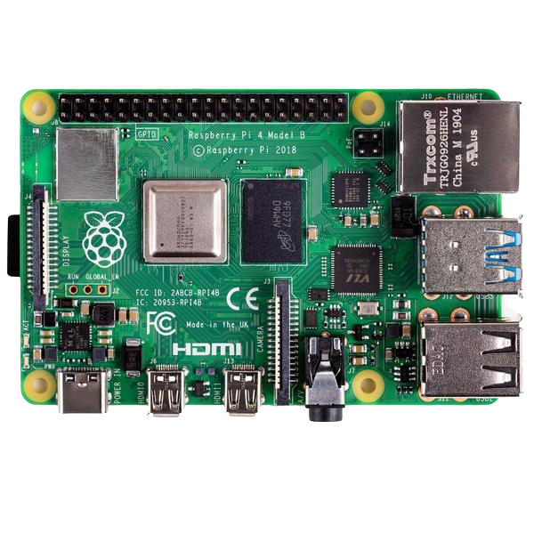
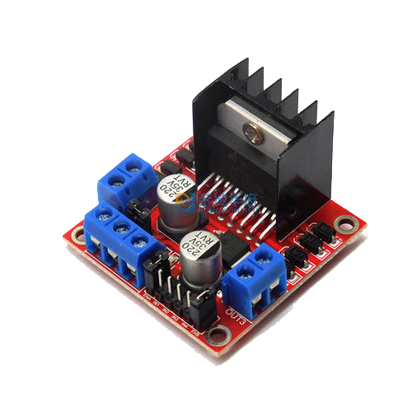
Sweeping Robot -Team 36
LiDar
SLAM (simultaneous localization and mapping)
Motor
Motor Drive
Raspberry Pi
And Sweep Your Room

Slide 2
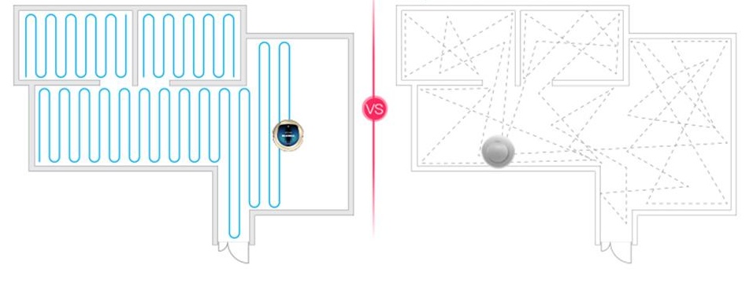
Part 1-Scan
Part 2- Location
Part 3-Navigation
Final: Sweep your room By route planning
选题的目的与意义

